Slide 1
GROOMING

Slide 2
AGENDA
GROOMING
BODY LANGUAGE
PROFESSIONAL ETIQUETTE

Slide 3
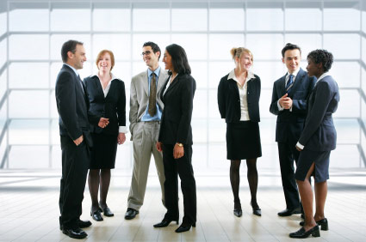
“PEOPLE LEARN BEST NOT BY BEING TOLD, BUT BY EXPERIENCING THE CONSEQUENCES OF THEIR THOUGHTS AND ACTIONS”

Slide 4
Grooming and Its Importance
It is the process of making yourself look neat and attractive.
The things which you do to make yourself and your appearance tidy and pleasant.
Grooming is important for a positive self-image and to encourage and assist the resident to maintain a pleasing and attractive appearance.

Slide 5
Grooming Fundamentals & Levels
Individual Level – Personal grooming
Group Level - Grooming of a team
Organization Level – Grooming of a company

Slide 6
Personal Grooming Fundamentals
Hair clean and styled appropriately
Clean nails, skin and teeth
Many professionals wear make-up
(depends on field)
Check fragrance and clothing care

Slide 7
People Perceptions from Groomed appearance of Professionals
Professionalism
Level of sophistication
Intelligence
Credibility or Reliability
Respect

Slide 8
BODY LANGUAGE

Slide 10
DO YOU KNOW WHAT YOU ARE SAYING?

Slide 11
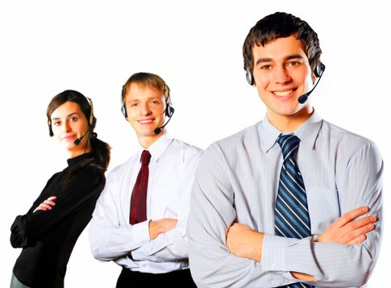
BODY LANGUAGE
Non-verbal mode communication
We do in every single aspect of our interaction with another person
It is like mirror that tells us what the other person thinks and feels in response to our words or actions.

Slide 12
BODY LANGUAGE MATTERS
Positive / Aggressive
Cool & Calm
Nervous / Scared
Active
Passive / Dull
Negative / Weak

Slide 14
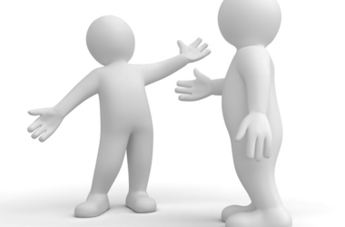
What is nonverbal communication?
Nonverbal Communication = Communication without words
Nonverbal communication is a process of communication through sending and receiving wordless messages.

Slide 15
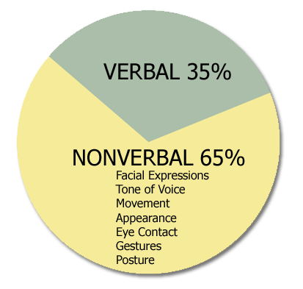
Importance of Nonverbal Communication
Verbal & nonverbal Communication plays an important role in how people interact with one another. People are using around 35% verbal communication and 65% nonverbal communication in daily life. Nonverbal communication has also cultural meaning

Slide 16
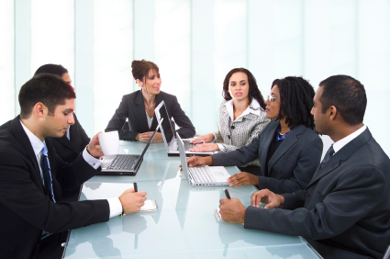
TIPS TO GOOD COMMUNICATION SKILLS
Maintain eye contact with the audience
Body awareness
Gestures and expressions
Convey one’s thought clearly
Practice effective Communication

Slide 17
EFFECTIVE COMMUNICATION…
It is two way
It involves active listening
It reflects the accountability of speaker and listener
It utilizes feedback
It is free of stress
It is clear

Slide 18
EFFECTIVE COMMUNICATION…
It is two way
It involves active listening
It reflects the accountability of speaker and listener
It utilizes feedback
It is free of stress
It is clear

Slide 19
Etiquette Basics Creating a positive image
Behavior:
Exhibit a positive attitude and pleasant demeanor
Use a firm handshake
Maintain good eye contact
Appropriate introductions – introduce someone by their title and last name (Ms. Mrs. Mr. Dr. Smith), unless otherwise specified
Rise when you are introducing someone or you are being introduced
Nonverbal communication is important
Show common respect and consideration for others

Slide 20
Professional Appearance
Grooming is fundamental
Hair clean and styled appropriately
Clean nails, skin and teeth
Many professionals wear make-up
(depends on field)
Check fragrance and clothing care

Slide 21
Office Etiquette

Slide 22
Introduction
'Etiquette' is a French word which means a 'ticket', on ceremonial or other important occasions a 'ticket' of instructions was issued to visitors detailing what they should do.
Thus the ticket enlists the rules of decorous behavior observed in a polite society.
In a professional sense this includes behavior towards clients and colleagues which is in their best interests.

Slide 23
E-mail etiquette
Be concise and to the point
Answer all questions
Use proper spelling, grammar and punctuation where needed
Do not attach unnecessary files
Notes:
Be concise and to the point : Keep you email message short and to the point. Sentences like "I hope this email finds you alive and well" look good only in letter correspondence.
Answer all questions
Use proper spelling, grammar and punctuation where needed : An email with spelling mistakes or grammatical errors indicate that you have written the message in a non-serious mood and may convey a bad impression.
Do not attach unnecessary files

Slide 24
E-mail etiquette Contd..
Do not overuse the high priority option
Do not write in Capitals
Read the email before you send
Do not overuse reply to all
Do not forward chain letters
Notes:
Do not forward chain letters, without requesting delivery and read receipts
Do not overuse the high priority option
Do not write in Capitals : USING ALL CAPITAL LETTERS IS NOT ONLY RUDE AND IRRITATING, IT'S ALSO HARD TO READ. Save your caps for special occasions, such as those times when you want your recipient to know you're shouting.
Read the email before you send : Do not hit the Send button without doing a spell check. Always read the message before broadcasting it to the world.
Do not overuse reply to all

Slide 25
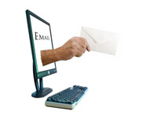
E-mail etiquette Contd..
Never use email to discuss confidential issues
Use meaningful subject avoiding URGENT or
IMPORTANT
Don't ever forward any junk mail
Don't reply to Spam
Notes:
Never use email to discuss confidential issues
Use meaningful subject avoiding URGENT or IMPORTANT : The email subject should be detailed enough to give the recipient an idea about the email content without having to open it. Single words like "Hi" or "Hello" or "Help" are a strict no-no. Think of meaningful but short titles.
Don't ever forward any junk mail related to offense or obscene remarks
Don't reply to Spam

Slide 26
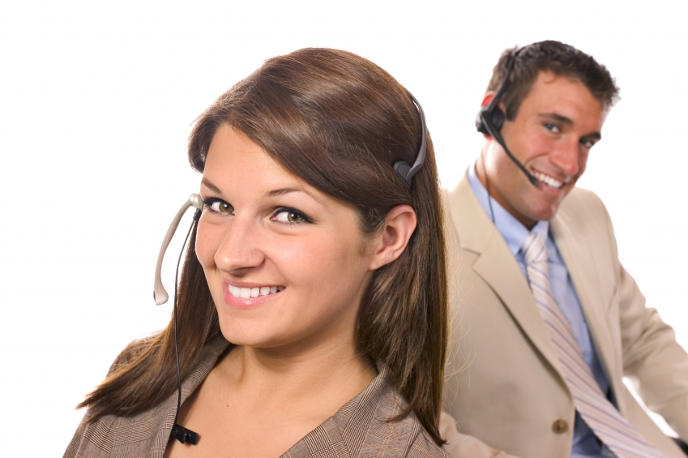
Telephone etiquette

Slide 27
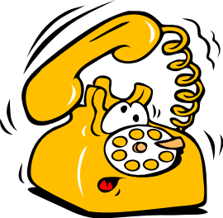
Pre-call preparation
Feel good about your work
Smile
Have a positive attitude
Place the receiver of the telephone correctly
Organize your desk

Slide 28
Answering calls for others
Identify yourself and the company
Offer assistance in the absence of others
Do not make commitments for others
Take accurate messages

Slide 29
Hold procedure & Transferring calls
Seek permission
Specify the duration
Explain the reason for the transfer
Wait for the customer’s response
Get back to the customer in the committed time frame

Slide 30
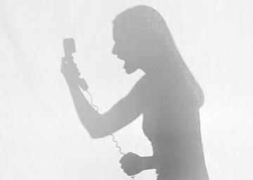
Handling complaints
Listen carefully
Convey sincere interest and be empathetic
Agree as often as possible
Remain calm and courteous. DO NOT ARGUE!
Do not interrupt
Do not blame co-workers

Slide 31
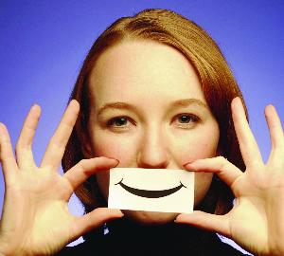
Handling complaints contd..
Explain clearly
Do not make unrealistic promises
Apologize
Act fast
Follow up

Slide 32
Call closure
Summarize what has been discussed
Ask if you can provide further assistance
End on a positive note

Slide 33
While closing the call
Have a pleasant tone and be courteous
Don’t sound rushed
Pause at appropriate places

Slide 34
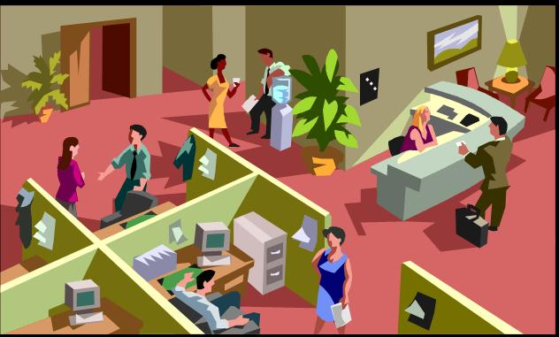
Work Etiquette

Slide 35
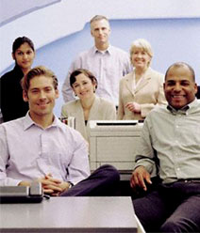
Personal & Professional boundaries
Refrain from using office supplies for personal use
Refrain from using swear words
Avoid emotional outbursts
Don’t groom yourself in public
Pick up after yourself
Respect others’ cubicle/office space

Slide 36
Presented By
Mr.V.S.Harshith Babu, AP1-MBA
&
Mr.T.C.Suriyanarayanaprabhu, AP1-MBA
THANK YOU

